Slide 1
Dvir Netanely
Introductory Talk
Shamir’s Group, TAU
Group Meeting, Dec 2011

Slide 2

HUJI

Slide 3
Predicting sRNA targets in E.Coli
The Hebrew University of Jerusalem
Dvir Netanely & Noa Gordon
CS-LS Joint Program - Final Project
Supervised by
Ruti Hershberg, Prof. Hanah Margalit
Notes:
נועה: שלום, אני נועה.
דביר: ואני דביר.
נועה ודביר: תשתתפו, אנחנו לא נושכים.

Slide 4

Science's top ten: Discovery of genes' 'control switches' named top advance of 2002
The discovery that a class of molecules called "small RNAs" control much of a gene's behavior was named 2002's most important scientific breakthrough by the journal Science

Slide 5
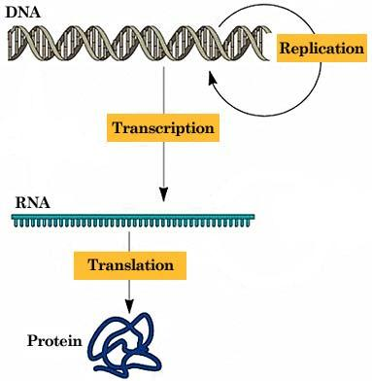
The Central Dogma Of Molecular Biology

Slide 6
Small RNA (sRNA)
50-400bp RNA molecules, abundant in bacteria
Not translated to protein but function directly as structural, regulatory or even catalytic RNAs
Involved in:
  Transcriptional regulation
  RNA processing and modification
  Messenger RNA stability and translocation
  Translation regulation

Slide 7
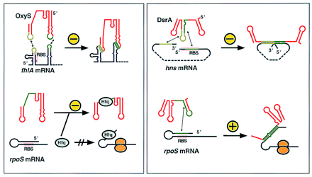
Example: sRNA regulation through basepairing
The Kissing Complex model
"Switching On and Off with RNA".
Altuvia S., Wagner E. (2001)

Slide 8
Example: sRNA regulation through basepairing
dsrA
"Switching On and Off with RNA".
Altuvia S., Wagner E. (2001)

Slide 9
Discovery of sRNAs
First few were discovered by chance, and found to have regulatory function
Computational approaches were later employed to predict new sRNAs.
During 2001, several works were published and 55 new sRNAs were predicted and identified
Notes:
New bands found in gel electrophoresis
Cloned genomic fragments that modulate certain activities
Co-purification of overproduced protein
Complete genome search based on parameters common to sRNAs
Whole genome expression analysis
Conservation between species

Slide 10
The Challenge
Small number of examples (most sRNAs have no known targets)
  Can’t learn
  Use heuristic approach
Known examples have different characterization which vary in large number of parameters

Slide 11
Known targets analysis
We have decided to solely concentrate on the RNA-RNA basepairing mechanism
The first step was to examine the few known sRNA-target examples, trying to define what are the parameters that characterizes a good match

Slide 12
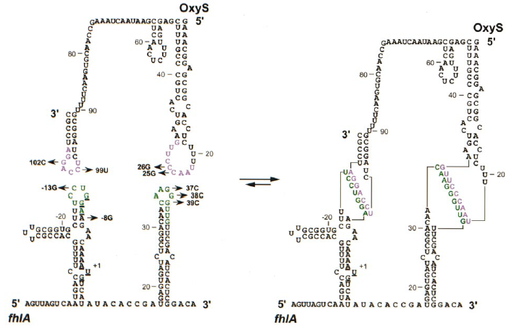
Example characterization
sRNA: oxyS, Target gene: fhlA
Position - AUG
Length
Looping
Basepairing
2 hits
Argaman L. ,Altuvia S. 2000

Slide 13
SRTF©
sRNA Target Finder

Slide 14
The SRTF program
For a given sRNA sequence, the SRTF program grades all E. coli genes by their relative quality as target genes

Slide 15
SRTF’s Input
sRNA annotation
The complete E. coli genome file including annotations, downloaded from NCBI.
MFold output files
Configuration parameters

Slide 16
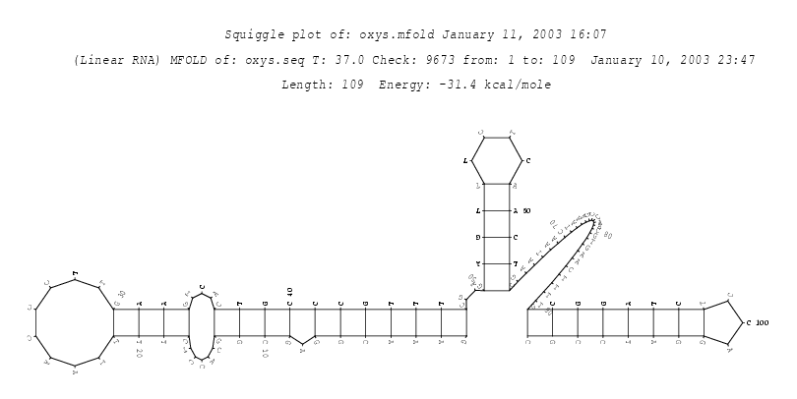
SRTF uses MFold output
The MFold program (Zuker M. 1989) predicts the secondary structure of a given RNA molecule.

Slide 17
E. Coli genome file
sRNA sequence
SRTF©
Phase 0
Produce sRNA secondary structure data
Phase 1
Scan genes for matches
Phase 2
Score all gene hits
90
87
75
64
32
Phase 3
Analyze & score hit combinations
Total Gene Score: 174
sRNA target gene candidates

Slide 18
Phase 0
Produce sRNA secondary structure data
Run MFold on the given sRNA sequence
For each base in the sequence, store its basepairing status
sRNA Position: | 1 | 2 | 3 | 4 | 5 | 6 | 7 | 8 | 9 | 10 | 11
Basepairing: | 0 | 0 | 0 | 1 | 1 | 1 | 1 | 0 | 0 | 1 | 0

Slide 19
Phase 1
Scanning the genome for hits
For all windows in the sRNA sequence, run against all windows in all genes and look for matches
For each match calculate free energy potential based on basepairing and stacking energy (Turner D.)

Slide 20
Phase 1
Scanning the genome for hits
sRNA: G C A G C U U C G A G C U G G C A U U
1
AUG
E. Coli genes
Hit 1: sRNA position: 3
Target gene position: 137
Length: 6
Energy: -8.4
All genes are scanned using a double sliding window. The output of this phase is a list of all hits found within each gene

Slide 21
Phase 1
Scanning the genome for hits
Two same length matches may have different free energy
^{5’} A – U ^{3’}
U - A
U - A
A - U
A - U
A – U
^{5’} G – U ^{3’}
C - G
C - G
G - U
G - U
G – U
Match Energy: -4.2 kcal/mol
Match Energy: -8.2 kcal/mol

Slide 22
Phase 1
Scanning the genome for hits
sRNA Pos: 6 80
OxyS: 3' CCTAGGACCTCTAGGCGTTTTCAAGTGCAACCGAAATCAATAAGCTCAACTCTTTGAGAGCTTTGCCCGTCACTGAAGTTCCCAATTTT
fhlA: 5‘ TGCGGTGCTTTCCTGGAAGAACAAAATGTCATATACACCGATGAGTGATCTCGGACAACAAGGGTTGTTCGACATCACTCGGACACTA
Gene Pos: -15 1 34
sRNA pos: 6
Target pos: -15
Length: 7
energy -15.4 kcal/mol
sRNA pos: 80
Target pos: 34
Length: 9
energy -12.1 kcal/mol
HIT = (sRNA pos, target pos, length, energy)

Slide 23
Phase 2
Hit scoring
Match Energy
Target Gene Position
sRNA Base Pairing
sRNA Extension
Match Length
15%
40%
15%
15%
15%
Hit Score

Slide 24

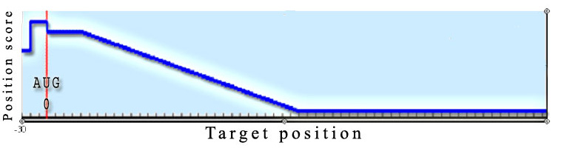
Target Gene Position
Hits which are positioned around the gene’s translation initiation site (AUG) are more likely to influence translation.

Slide 25
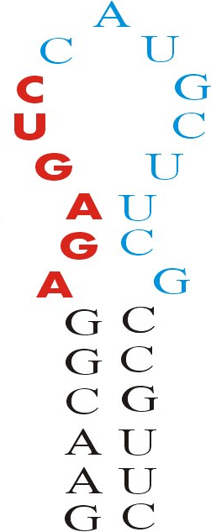
sRNA Basepairing score
The basepairing score of a hit determines the number of sRNA bases which are not basepaired.
Basepaired regions will have to unbind before they can bind to the target sequence and thus will compete with the free energy of the potential sRNA-target match.

Slide 26
sRNA Extension score
A Match located on an extension of the sRNA secondary structure may have improved accessibility to the target mRNA.
The extension score determines the distance from the stem beginning.

Slide 27
Phase 2
Hit scoring
Match Energy
Target Gene Position
sRNA Base Pairing
sRNA Extension
Match Length
15%
40%
15%
15%
15%
Hit Score
Hit Score = (length / lengthThreshold ) * l00 * lengthWeight + (energy / energyThreshold ) * 100 * energyWeight + (positionScore / positionThreshold ) * 100 * positionWeight + (extensionScore / extensionThreshold ) * 100 * extensionWeight + (bpScore / bpThreshold) * 100 * bpWeight

Slide 28
Phase 3
Analyzing hit combinations for each gene
After scoring hits independently, we score hit combinations (pairs).
Pair score includes:
  Sum of hit scores
  Distance Penalty
  Ratio Bonus
  Cover Bonus
sRNA
Target gene

Slide 29
Phase 3
Analyzing hit combinations for each gene
Distance penalty – penalize hit pairs that are distantly located on the target gene.
sRNA
sRNA
Target gene
Target gene

Slide 30
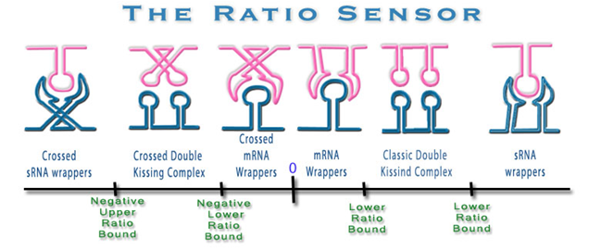
Phase 3
Analyzing hit combinations for each gene
Ratio coefficient
sRNA
Target gene

Slide 31
Phase 3
Analyzing hit combinations for each gene
Cover Bonus – Gives bonus to hit pairs that encapsulates the translation critical region of the Shine-Dalgarno region and translation start codon (bp: -8..+3) .
sRNA
Target gene

Slide 32
Phase 3
Analyzing hit combinations for each gene
Select best combination of scored hits in order to gain maximal total gene score.
Different binding models can be applied
sRNA
Target gene

Slide 33
Phase 3
Analyzing hit combinations for each gene
Final gene Score:
Maximum over of all single hit scores, and pair scores
Total Gene Grade: G_{m}= max ( S_{ij} , S_{i}) i=1..K , j=1..K K = number of hits found on gene m S_{i} = Score of single hit j S_{ij} = Score of hits pair (i,j)
Pair Score: S_{ij} = S_{i} + S_{j} – DistancePenalty(i,j) + RatioBonus(I,j) + CoverFractionBonus(I,j)

Slide 34
E. Coli genome file
sRNA sequence
SRTF©
Phase 0
Produce sRNA secondary structure data
Phase 1
Scan genes for matches
Generates a list of hits for each gene.
HIT = (sRNA pos, target pos, length, energy)
Phase 2
Score all gene hits
For each gene, score all hits independently according to sRNA basepairing & looping, match energy & length and target gene position
Phase 3
Analyze & score hit combinations
For each gene, choose the best hit combination and returns its score as the final gene score
sRNA target gene candidates

Slide 35
Results

Slide 36
Example used for SRTF development
New known target , binding location unknown
New known target , binding location unknown

Slide 37
SRTF Output for the known example:
OxyS - fhlA

Slide 38
SRTF Output for the newly discovered target:
OxyS - narZ

Slide 40

WIS

Slide 41
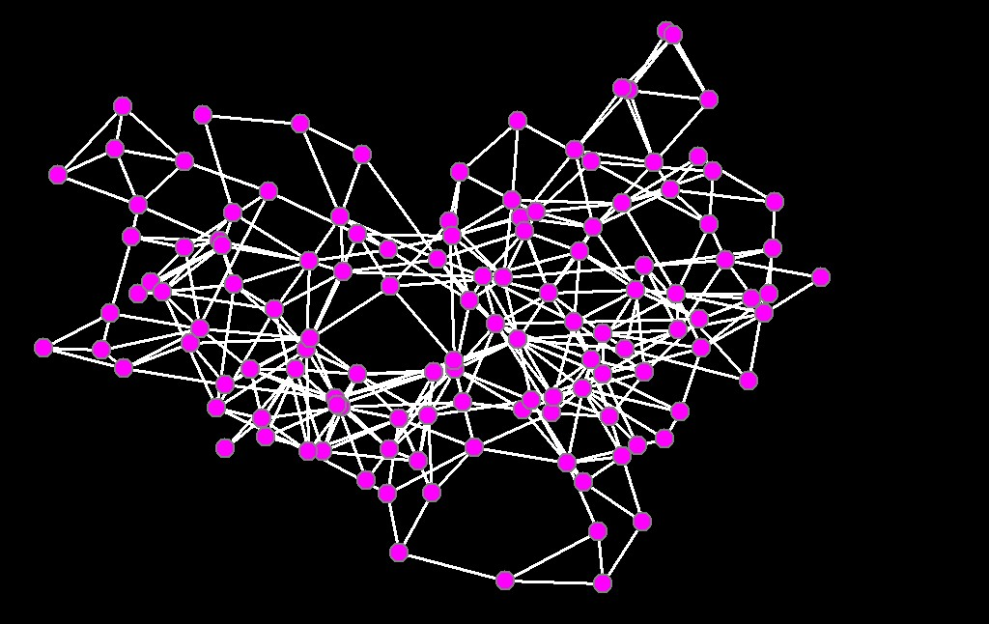
WIS – Rotation I
Prof. Shmuel Pietrokovski’s Lab
SARIG Project - Predicting active site in proteins (PERL)
ATOMS
AMINO ACIDS
RESIDUE NETWORK GRAPH
aa
aa
aa
Network analysis of protein structures identifies functional residues, Amitai G, Shemesh A, Sitbon E, Shklyar M, Netanely D, Venger I & Pietrokovski S (2004) Journal of Molecular Biology, Volume 344(4), 1135-1146

Slide 42
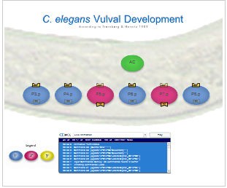
WIS – Rotation III
Dr. Jasmin Fisher, Prof. David Harel’s Lab
Developing a reactive animation responding in real time to a biological simulation model (FLASH)
Not Predefined
Quite Generic
Activate

Slide 43
WIS – Eytan Domany’s Lab

Slide 44
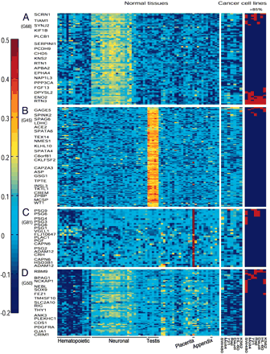
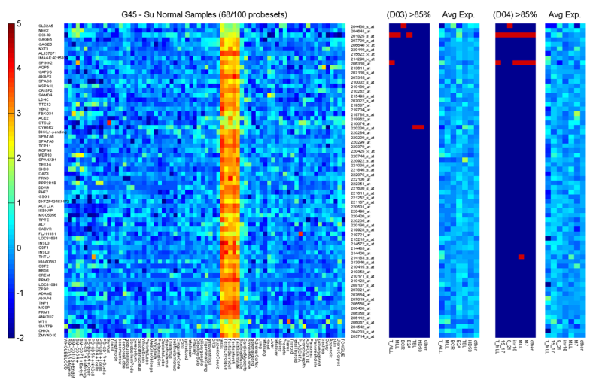
Leukemic Over Expression of Tissue Specific Genes
WIS – Eytan Domany’s Lab I
Induction in myeloid leukemic cells of genes that are expressed in different normal tissues, Lotem J, Benjamin H, Netanely D, Domany E, Sachs L. (2004) PNAS
Human cancers overexpress genes that are specific to a variety of normal human tissues, Joseph Lotem, Dvir Netanely, Eytan Domany, and Leo Sachs (2005) PNAS

Slide 45
Leukemic Over Expression of Tissue Specific Genes
WIS – Eytan Domany’s Lab I
DATA USED:
Su et al. 2004
  72 normal tissue samples
  7 cancer cell lines
Downing et al. 2003, 2004
  132 pediatric patients with different acute lymphoid leukemia (ALL) subtypes
  130 pediatric patients with different acute myeloid leukemia (AML) subtypes
  5 pediatric patients with T-ALL with a rearranged MLL gene
Analysis 1
Analysis 2
Data preprocessing,
SPC clustering,
Extensive biological analysis

Slide 46
Leukemic Over Expression of Tissue Specific Genes
WIS – Eytan Domany’s Lab I
QUESTION POSED:
Are up-regulated genes in cancer cells limited only to those genes that are normally preferentially expressed in the same tissues from which the cancer originated?
Are the tissue specific characteristics of the genes that are up-regulated in cancer universal, or do they vary between different human cancer cell lines and different subtypes of human leukemia from patients?

Slide 47
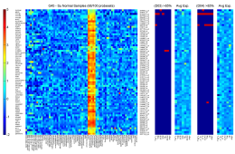
Leukemic Over Expression of Tissue Specific Genes
WIS – Eytan Domany’s Lab I
RESULTS:
Leukemic cell lines highly expressed various genes that are preferentially expressed in tissues other than those from which the cancers originated including neuronal, liver, kidney, thyroid, lung or placenta.
Most of these genes were over expressed only in a single cancer subtype, indicating that the different cancer cells show differences both in the number and the identity of their over expressed genes.
It is suggested that the ability to over express genes that are normally preferentially expressed in tissues other than the cancer’s origin, is a general property of cancer cells that plays a major role in determining the behavior of the cancers, including their metastatic potential and possible trans-differentiation therapy paths.

Slide 48
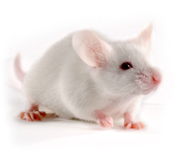
WIS – Eytan Domany’s Lab II
More gene expression analysis…
“Analysis of hippocampal gene expression suggested that immune-dependent spatial memory performance was associated with the expression of insulin-like growth factor (Igf1)”
    Age-dependent spatial memory loss can be partially restored by immune activation. Ron-Harel N, Segev Y, Lewitus GM, Cardon M, Ziv Y, Netanely D, Jacob-Hirsch J, Amariglio N, Rechavi G, Domany E, Schwartz M. (2008) Rejuvenation Res.
Preprocessing,
Supervised tests

Slide 49
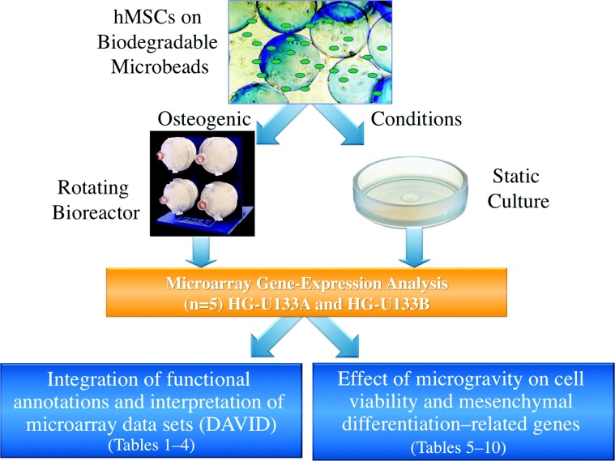
WIS – Eytan Domany’s Lab III
And more gene expression analysis… Microgravity
“The data sets showed significant decreases in osteogenic and chondrogenic gene expression and an increase in adipogenic gene expression, indicating that ex vivo adipose tissue engineering may benefit from simulated microgravity”
    The effect of simulated microgravity on human mesenchymal stem cells cultured in an osteogenic differentiation system: a bioinformatics study. Sheyn D, Pelled G, Netanely D, Domany E, Gazit D. (2010) Tissue Eng.
Preprocessing,
Supervised tests,
Gene ontology enrichment tests

Slide 50
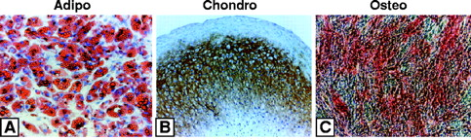
WIS – Eytan Domany’s Lab IV
Mesenchymal Stem Cell Differentiation
Project outline
  In this project we have analyzed gene expression profiles along the differentiation process of embryonic and mesenchymal stem cells into mature bone and fat tissues.
Collaboration with
  Prof. David Givol, WIS
  Prof. Dan Gazit and Dr. Hadi Haslan, HUJI

Slide 51
Microarray Dataset Scheme
Mesenchymal Stem Cell Differentiation
Embryonic
Stem Cells
x3
Embryonic Stem Cells
Adult Stem Cells
Mesenchymal
Stem Cells
DONOR 1
x3
K65,K66,K67
Osteogenesis Control medium
DONOR 2
x2
Adipogenesis Control medium
DONOR 3
x3
K56,K57
K59,K60,K61
Differentiated
Cells
Osteogenesis Induction medium
DONOR 2
x3
Adipogenesis Induction medium
DONOR 3
x3
K53,K54,K55
K62,K63,K64
Bone
Fat

Slide 52
Project Goals
Mesenchymal Stem Cell Differentiation
Global dataset gene expression exploration
  What are the prominent differentiation dependant expression patterns observed in the data?
  How many genes go up/down along the differentiation pathway?
  Exploration of internal relationships between the samples types.
Identification of biological themes, pathways and genes involved in mesenchymal differentiation
  What are the major pathways taking part in the differentiation process?
  Which genes play a pivotal role during the differentiation pathway?
Notes:
עבודות קודמות – JUST IN CASE

Slide 53
Analysis outline
Mesenchymal Stem Cell Differentiation
Global gene expression analysis along the differentiation pathway
Counting differentially expressed genes
Identification of genes changed upon induction
Clustering analysis
Notes:
מתחילים עם ניתוח כללי ברמת השבב כולו (קודם לא כמותי ואח"כ כמותי) ואח"כ יורדים לרמת הקלסטרים

Slide 54
RESULTS

Slide 55
Comparing difference distributions
Mesenchymal Stem Cell Differentiation
Analysis 1: Global gene expression analysis along the differentiation pathway
Compared pair | Diff. Mean | Diff. STD | Rank sum pValue
ESC – Fat-Induction | 0.185 | 2.070 | 1.75e-013
ESC – Fat-Control | 0.182 | 2.093 | 5.90e-012
ESC - MSC | 0.216 | 1.862 | 7.10e-015
MSC – Fat-Induction | -0.031 | 1.151 | 0.57
MSC- Fat-Control | -0.033 | 1.092 | 0.34
Fat-Control – Fat-Induction | 0.002 | 0.809 | 0.68
Compared pair | Diff. Mean | Diff. STD | Ranksum pValue
ESC – Bone-Induction | 0.136 | 1.947 | 3.08e-005
ESC – Bone-Control | 0.157 | 2.022 | 2.64e-008
ESC - MSC | 0.216 | 1.862 | 7.05e-015
MSC – Bone-Induction | -0.080 | 1.046 | 0.0005
MSC- Bone-Control | -0.058 | 1.004 | 0.02
Bone-Control – Bone-Induction | 0.002 | 0.809 | 0.17
Notes:
עקומות צרות מעידות על רמת שוני נמוכה ברמת השבב כולו, עקומות רחבות מראות שינויים גדולים בין הרבה גנים
Wide distributions indicate that many genes have a high fold change between the two sample types and are therefore correlated with significant expression level differences.

Slide 56
Mesenchymal Stem Cell Differentiation
Analysis 2: Counting differentially expressed genes
MSC
ESC
Comparing expression levels of ESC and MSC differentially expressed genes. 12,461 differentially expressed probe-sets that passed an ANOVA test over the six sample types, with FDR of 0.05, are plotted along the X-axis, sorted by their averaged expression on the ESC samples. Black dots represent probe-set expression on the ESC samples, blue dots represent expression on the MSC samples.

Slide 57
Mesenchymal Stem Cell Differentiation
Analysis 2: Counting differentially expressed genes
MSC
ESC
6980 probe-sets are higher on ESC compared to MSC (dots under the line)
5302 probe-sets are lower on ESC compared to MSC (dots above the line)
179 probe-sets are equal on both ESC and MSC (dots on the line)
There are 1,678 more blue dots under the black line compared to blue dots above the line, indicating that out of the 12,461 differentially expressed genes, 1,678 (13.4%) are expressed higher on ESC compared to MSC

Slide 58
Conclusions
Mesenchymal Stem Cell Differentiation
Analysis 2: Counting differentially expressed genes
ESCs express more over-expressed probe-sets compared with all mesenchymal sample types.
MSCs express more over-expressed probe-sets compared with Fat samples, but more under-expressed probe-sets compared with Bone samples.
“Just In Case”
Donor variance

Slide 59
Mesenchymal Stem Cell Differentiation
Analysis 3: Identification of genes changed upon induction
Differentiation of MSC to Bone
734 differentially expressed probe-sets (passed t-test comparing Bone-Control and Bone-Induction) were profiled using 10 bins

Slide 60
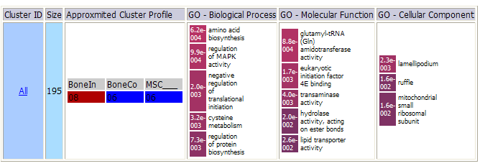
Mesenchymal Stem Cell Differentiation
Analysis 3: Identification of genes changed upon induction
Differentiation of MSC to Bone, INCREASING PROFILES
195 probe-sets
http://bioinfo2.weizmann.ac.il/~netanely/Thesis/SI1/bone_up/3_results.html

Slide 61
Mesenchymal Stem Cell Differentiation
Analysis 4
Clustering analysis
We have used the CTWC (Coupled Two-Way Clustering) algorithm to cluster the 7,000 most variable probe-sets over all six sample types.
The clustering operation was applied on the standardized dataset using default CTWC parameters, and yielded 43 stable clusters.
Gene ontology enrichment was calculated for all clusters.
Dataset preprocessing:
  Variability filter (Top 7000 varibale probe-sets were filtered in)
  A threshold of 20 followed by log2 transformation was then applied to the data.
  ROWS were standardized

Slide 62
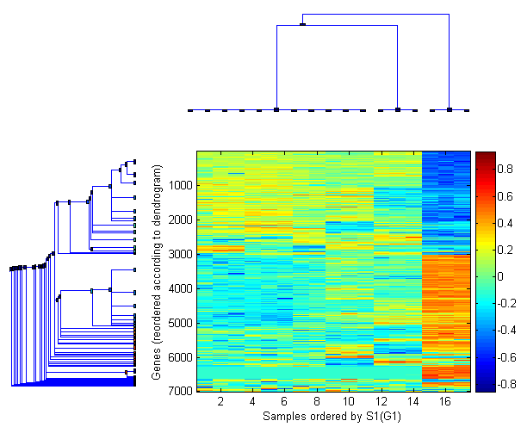
Mesenchymal Stem Cell Differentiation
Analysis 4: Clustering analysis
FAT
BONE
MSC
ESC
Notes:
יחסים בין דגימות
יחסים בין גנים

Slide 63
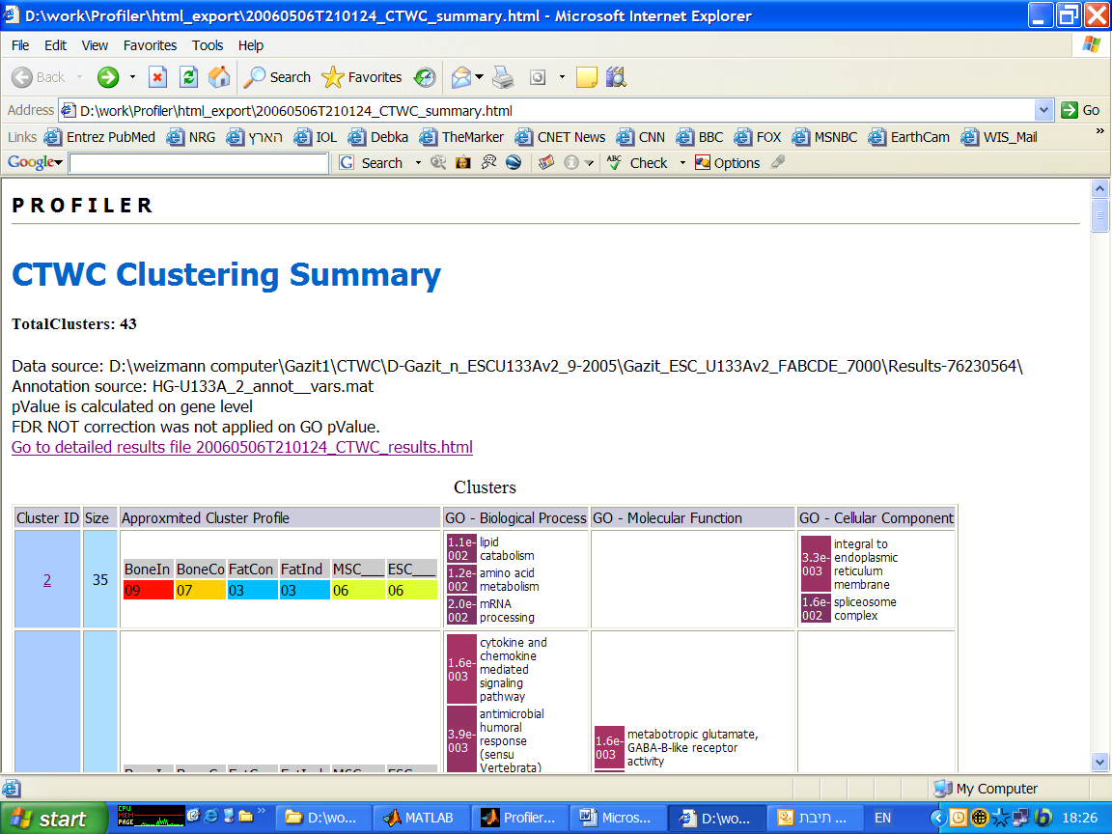
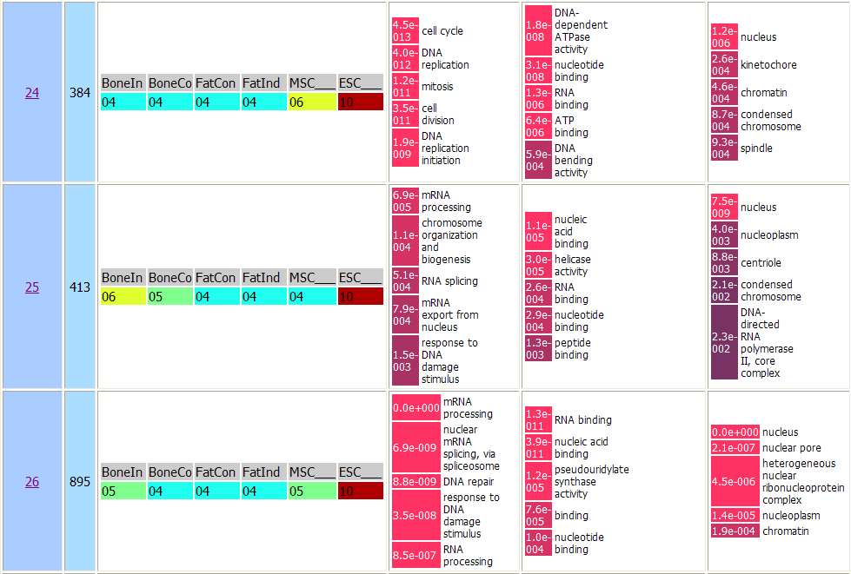
Mesenchymal Stem Cell Differentiation
Analysis 4: Clustering analysis
Clusters over-expressed in ESCs are enriched with ‘Biological process’ GO terms related to mitosis, cell-cycle, DNA replication and mRNA processing. In the ‘Molecular function’ class, they are enriched mainly in nucleic acid binding terms, and in the ‘Cellular component’ class they are enriched in the nucleus.

Slide 64
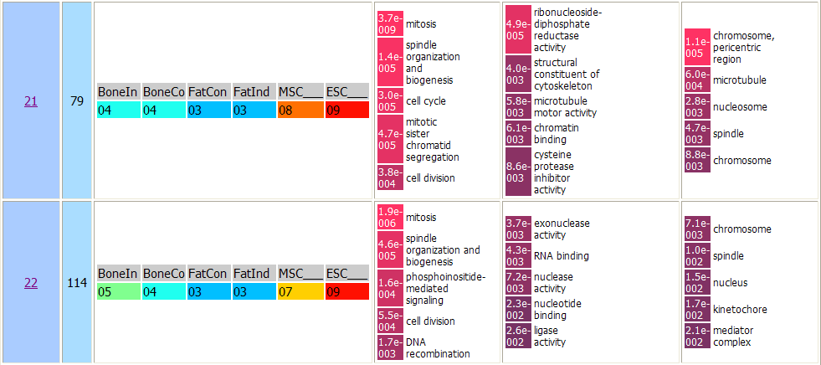
Mesenchymal Stem Cell Differentiation
Analysis 4: Clustering analysis
Similarly, clusters exhibiting over-expression in both ESC and MSC samples, were found to be enriched with mitosis, cell-cycle and spindle-organization.

Slide 65
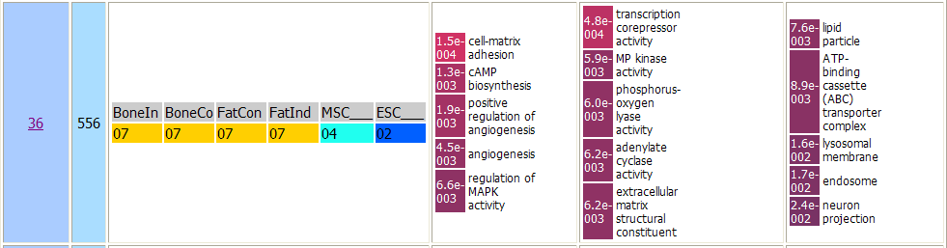
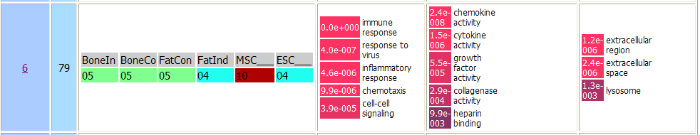
Mesenchymal Stem Cell Differentiation
Analysis 4: Clustering analysis
Exhibiting an opposite profile, a gene cluster under-expressed in ESC was found to be enriched with cell-matrix adhesion. The cluster includes probe-sets whose expression is elevated along the differentiation pathway.
Probe-sets exclusively over-expressed in MSC were found to be enriched with immune related GO terms such as immune-response, inflammatory response and chemotaxis. Chemokine and cytokine activity are among the enriched GO terms in the ‘Molecular function’ class.

Slide 66
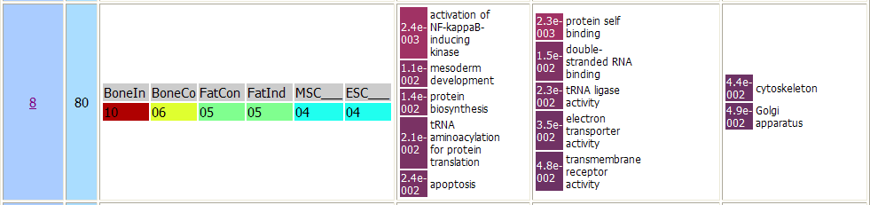
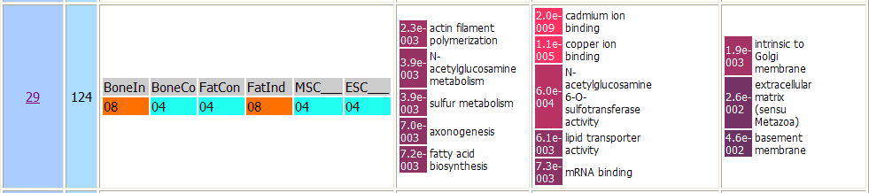
Mesenchymal Stem Cell Differentiation
Analysis 4: Clustering analysis

Slide 67
Profiler

Slide 68
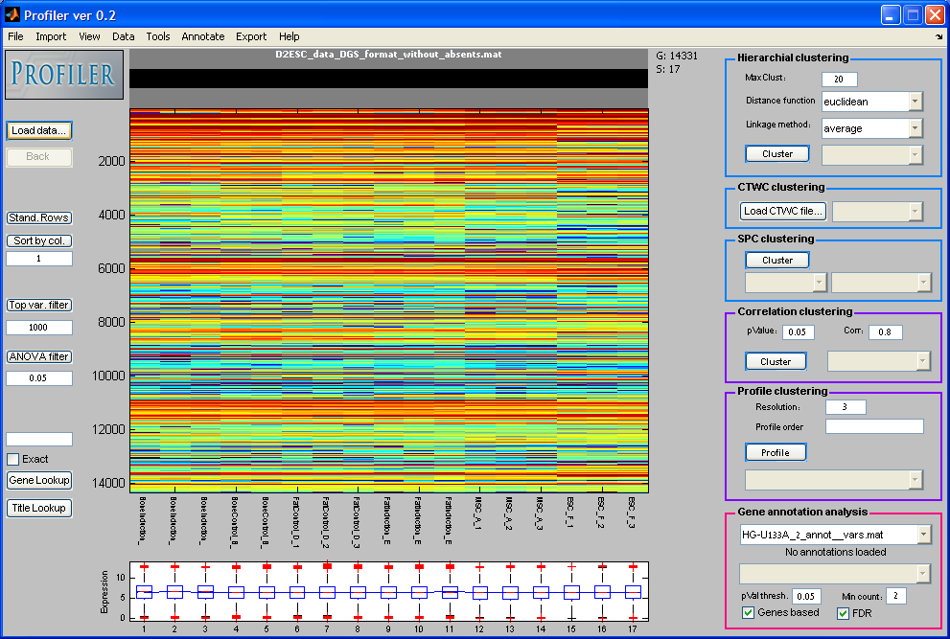
Profiler

Slide 69
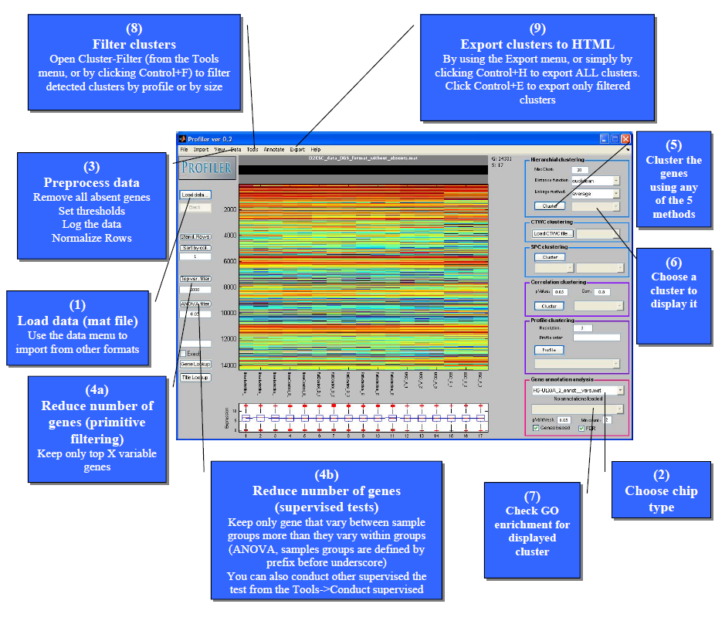
Profiler

Slide 70
Standard steps in gene expression data analysis
Data import
Preprocessing
Gene filtering
General dataset exploration
Supervised tests
Clustering
Test for gene annotation enrichments
Export of results to a nice colorful format

Slide 71
Motivation
Maximal workflow automation
Interactive-ness

Slide 72
Standard steps in gene expression data analysis
Import data
  From text
  From a matlab file
Preprocess
  Remove absents
  Threshold
  Log2 transformation
  Standardization of row (cols)
Filter out genes
  Removal of ALL-absent genes
  Removal of low variability genes
Supervised tests
  Find genes that change between 2 groups of samples (t-test, fold change, ranksum, ANOVA, fold-change, FDR)
Unsupervised tests
  Clustering
Test for gene annotation enrichment
  Gene ontology enrichment test
Export results to a nice colorful format

Slide 73
Profile Clustering

Slide 74
1 3 2

Slide 75
Dataset genes clustered by Profiles (resolution=3)
1 2 3
1 3 2
3 1 1
3 1 2
3 2 1

Slide 76
Profile Clustering
Intuitive
Very fast – it takes 30 secs to cluster 14,000 genes (using resolution 3)
Enables post filtering of clusters according to profiles

Slide 77
Each line represents a unique profile detected in current dataset
Line’s width represents the number of PS that belong to this profile (cluster size)

Slide 78
Data profiling
*Resolution=3, applied after ANOVA, row normalization

Slide 79
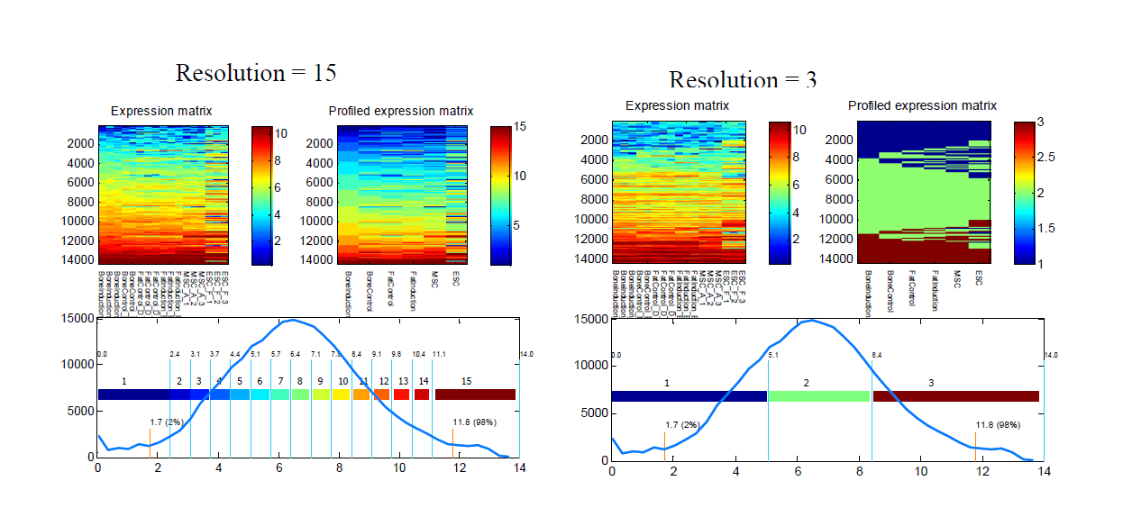
Data profiling

